Slide 1
Cloud Computing La nube: el futuro de la tecnología
Gerardo Ramos
Microsoft Student Partner
gerardo.ramos@student-partners.com

Slide 2
Agenda
Situaciones Actuales
La Nube - Cloud Computing
Microsoft en la Nube
Windows Azure
Modelo de Negocios

Slide 3
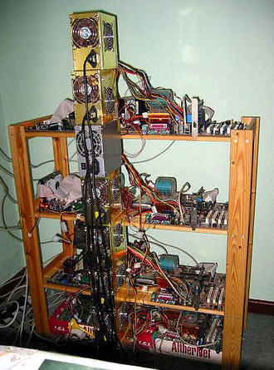
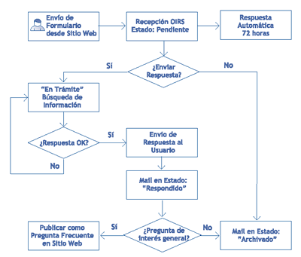
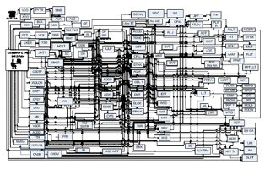
Situaciones

Slide 4
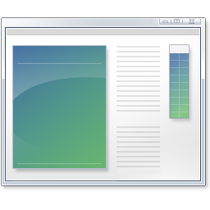
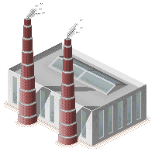
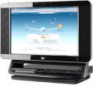
Alternativas - Servicios
SaaS
S+S

Slide 5
Cloud Services
Packaged Software
Infrastructure
(as a Service)
Platform
(as a Service)
Software
(as a Service)
Applications
Applications
You manage
Applications
Applications
Data
You manage
Data
Data
Data
Runtime
Runtime
Runtime
Runtime
Managed by vendor
You manage
Middleware
Middleware
Middleware
Middleware
Managed by vendor
O/S
O/S
O/S
O/S
Virtualization
Virtualization
Managed by vendor
Virtualization
Virtualization
Servers
Servers
Servers
Servers
Storage
Storage
Storage
Storage
Networking
Networking
Networking
Networking
Notes:
Slide Objectives:
Explain the differences and relationship between IaaS, PaaS, and SaaS in more detail.
Speaking Points:
Here’s another way to look at the cloud services taxonomy and how this taxonomy maps to the components in an IT infrastructure.
Packaged Software
With packaged software a customer would be responsible for managing the entire stack – ranging from the network connectivity to the applications.
IaaS
With Infrastructure as a Service, the lower levels of the stack are managed by a vendor. Some of these components can be provided by traditional hosters – in fact most of them have moved to having a virtualized offering.
Very few actually provide an OS
The customer is still responsible for managing the OS through the Applications.
For the developer, an obvious benefit with IaaS is that it frees the developer from many concerns when provisioning physical or virtual machines.
This was one of the earliest and primary use cases for Amazon Web Services Elastic Cloud Compute (EC2).
Developers were able to readily provision virtual machines (AMIs) on EC2, develop and test solutions and, often, run the results ‘in production’.
The only requirement was a credit card to pay for the services.
PaaS
With Platform as a Service, everything from the network connectivity through the runtime is provided and managed by the platform vendor.
The Windows Azure Platform best fits in this category today.
In fact because we don’t provide access to the underlying virtualization or operating system today, we’re often referred to as not providing IaaS.
PaaS offerings further reduce the developer burden by additionally supporting the platform runtime and related application services.
With PaaS, the developer can, almost immediately, begin creating the business logic for an application.
Potentially, the increases in productivity are considerable and, because the hardware and operational aspects of the cloud platform are also managed by the cloud platform provider, applications can quickly be taken from an idea to reality very quickly.
SaaS
Finally, with SaaS, a vendor provides the application and abstracts you from all of the underlying components.

Slide 6
La nube – Cloud Computing

Slide 7
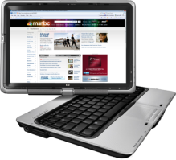
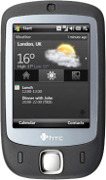
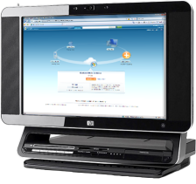
La nube para todos….
Servicios en la Nube
On-Premises

Slide 8
Servicios en la Nube
Servicios en la Nube

Slide 9
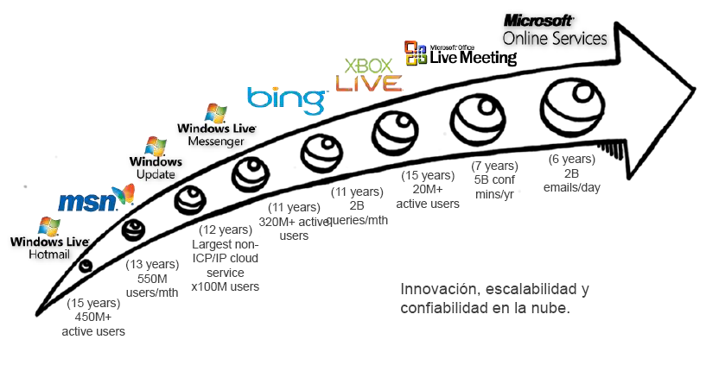
¿Es Microsoft Nuevo en la Nube?

Slide 10
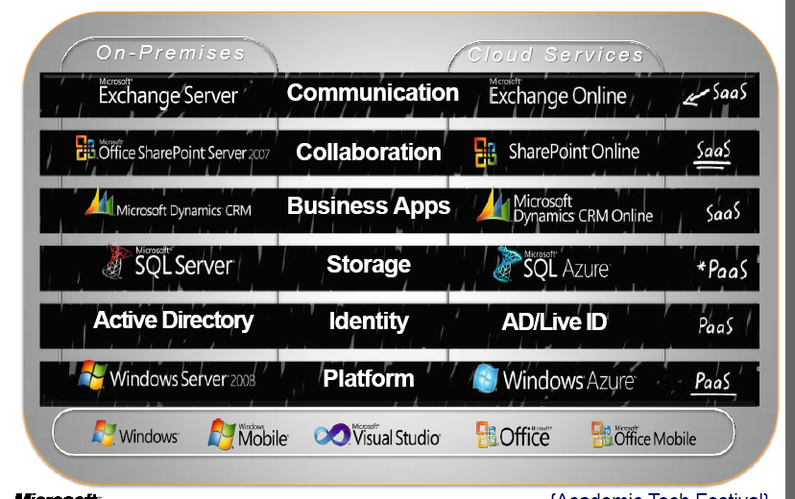
+ Servicios Microsoft

Slide 11
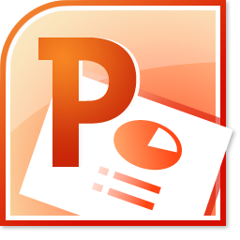
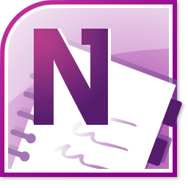

Slide 12
XML
Soap
Móvil y Escritorio
Software
Existente
Rest
Tu Aplicacion en la Nube
Desarrolladores
Lenguajes Terceros

Slide 13
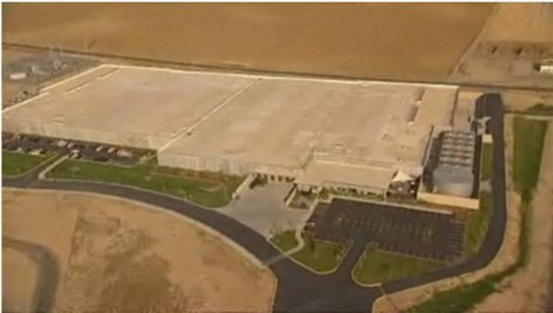
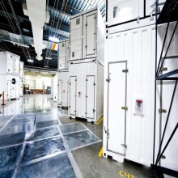
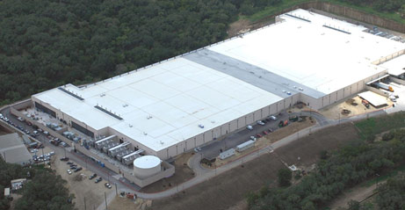

Slide 14
Windows Azure Platform
Cómputo: Ambiente de cómputo virtualizado basado en Windows Server
Almacenamiento: Durable, escalable, almacenamiento disponible
Administración: Automatizado, manejado por el modelo de servicio
Database: Procesamiento relacional
AppFabric
Bus de Servicios: Conectividad entre aplicaciones y servicios
Control de Acceso: Patrones de acceso

Slide 15
Windows Azure
Core
Cómputo
Almacenamiento
Sql Azure
DBMS
Huron
App Fabric
Bus de Servicios
Seguridad

Slide 16
Core
Cómputo
Web Role
Worker Role
Almacenamiento
Blobs
Tablas
Colas
Fabric Controller
Notes:
Instancia de Azure

Slide 17
Roles
Web Role
Worker Role
Windows Server 2008 x64
IIS 7
ASP.NET 3.5 SP1
FastCGI – PHP
Native Code
Full Trust
User Mode
Windows Server 2008 x64
.NET Start
Native Code
User Mode
Inbound any TCP Port

Slide 18
Windows Azure
Core
Cómputo
Almacenamiento
Sql Azure
DBMS
Data Sync
App Fabric
Bus de Servicios
Seguridad

Slide 19
SQL AZURE
DBMS
Data Sync

Slide 20
¿Qué tiene SQL Azure?
Estadísticas
Transacciones
Triggers
Tablas
Join
Variables de tablas
Funciones
Vistas
Datos Espaciales
Tablas y Vistas del Sistema
Constantes
Constraints
Cursores
Índices
Administración
Reconstrucción
Tablas Temporales
Locales
Palabras Reservadas
SPs

Slide 21
Windows Azure
Core
Cómputo
Almacenamiento
Sql Azure
DBMS
Huron
App Fabric
Bus de Servicios
Seguridad

Slide 22
App Fabric
Bus
Intra
Inter
Seguridad
Federación
Unificación
Autorización

Slide 23
Modelo de Negocios

Slide 24
Azure vs. Hosting
Administración Simplificada
Escalabilidad y Disponibilidad
Costeo Dinámico

Slide 25
Costeo Core
Cómputo
Almacenamiento
Ancho de Banda
$0.12/H
$0.15/GB
$0.01/10K Ops
$0.10/GB in
$0.15/GB out

Slide 26
Costeo SQL
Web
(hasta 5GB)
Business
(hasta 50GB)
Ancho de Banda
$9.99/mes/GB
$99.99/mes/10GB
$0.10/GB in
$0.15/GB out

Slide 27
Para trabajar en Azure
Conocimientos Previos en
ASP.NET
Windows Comunication Foundation
LINQ – Language Integrated Query
Herramientas
Visual Studio 2010
Windows Azure Tools for Visual Studio
Windows Azure AppFabric
SQL Server 2008 R2
Windows Azure Training Kit

Slide 28
Windows Azure - Resumido
Portal de Negocio
Portal de Desarrollo
User Code
REST
Servicios de Administracion
Runtime API
…
…
VM Setup
VS Tools
Storage Cluster
Compute Cluster
…
Cloud VM
WA SDK
REST
Escritorio
MSFT Datacenter
Notes:
Slide Objective
Introduce the plumbing of Windows Azure
Speaker Notes
Windows Azure Compute runs in a number of Microsoft run data centers around the world
There is a business portal for billing
A set of APIs for management (these are what is consumed by the portal but can use them directly)
A developer portal for creating and managing Windows Azure hosted services
Clusters of machines in each data center run the Windows Azure Compute and Storage services
Windows Azure compute is based around VM instances. These run a core operating system along with a set of Windows Azure specific APIs.
Developers deploy their custom code to Windows Azure via the Portal or the API
Notes

Slide 29
Conclusiones
Ejecutar - Almacenar
Datacenter Gigante
Se paga solo lo usado
Escalable
Disponible
Reducir tiempo y costo

Slide 30
Como Iniciar
Windows Azure Platform
http://www.azure.com
Microsoft Online
http://www.microsoft.com/online
Blog de Windows Azure en Español
http://blogs.msdn.com/b/warnov/archive/tags/azure/
Microsoft Cloud Services
http://www.microsoft.com/cloud
Gerardo Ramos
Gerardo.ramos@student-partners.com

Slide 31
© 2009 Microsoft Corporation. All rights reserved. Microsoft, Windows, Windows Vista and other product names are or may be registered trademarks and/or trademarks in the U.S. and/or other countries.
The information herein is for informational purposes only and represents the current view of Microsoft Corporation as of the date of this presentation. Because Microsoft must respond to changing market conditions, it should not be interpreted to be a commitment on the part of Microsoft, and Microsoft cannot guarantee the accuracy of any information provided after the date of this presentation. MICROSOFT MAKES NO WARRANTIES, EXPRESS, IMPLIED OR STATUTORY, AS TO THE INFORMATION IN THIS PRESENTATION.

